Slide 1
What is Clarity and how can it be Measured?
David Griesinger
David Griesinger Acoustics
www.davidgriesinger.com
617 331 8985

Slide 2
Let’s start with the conclusions
ISO3382 analyses for Clarity are based on obsolete theories of hearing. The evolution of the ear and brain demands that the direct sound be audible.
Current hall designs are turning live performances into spectacles for tourists, driving audiences to movies and recordings.
Current classroom design and sound reinforcement strive for loudness over engagement, understanding, and remembering.
The ancient Greeks knew better.
The ancient Greeks knew better.

Slide 3
Clarity should measure of the ease of extracting and remembering information
We will: demonstrate that we can easily perceive clear sound, but that ISO3382 measures fail to define or measure it,
show that the physics and physiology of signal extraction from a reverberant and noisy environment depend on the phases of harmonics in complex tones;
To which ISO3382 is completely blind,
and present ways of measuring Clarity using impulse responses and recordings of live speech.

Slide 4
What’s this about phase?
Phase is supposedly inaudible above about 1000Hz.
But this is only true if you use sine-waves as test signals
When you use speech or music, the statement is blatantly untrue!
The relative phase of harmonics above 1000Hz is essential to how we hear!

Slide 5
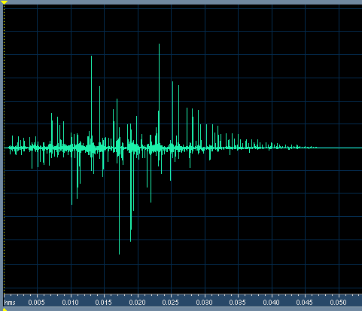

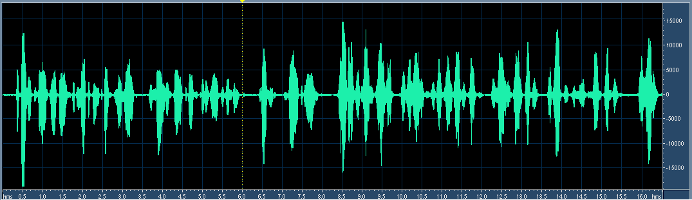
Example of Clarity for Speech
This impulse response has C50 and C80 = infinity. STI = 0.96, and RASTI = 0.93.
But the second utterance is muddy and distant because the IR randomizes the phase of harmonics above 1000Hz!!!
(Click for sound )

Slide 6
Why is Clarity Essential?
Because when sound is clear it is easy to remember and demands our attention.
Clear cannot be ignored. Great music and drama depend on this involuntary engagement.
The Ancient Greeks understood this very well!
Western classical music developed in dry spaces. Mozart would be shocked to hear modern halls.
Vaudeville presenters knew all about Clarity, and modern drama and cinema directors have not forgotten.
But the lesson has been lost in the design of modern music halls, operas, and classrooms.

Slide 7
Clarity is lost when live audiences see only backs.
Live performances demand human contact.
The essence of all live performance is aural contact with the closeness and presence of the performers.
And visual contact with their faces and fingers.
Modern hall design often loses both.

Slide 8
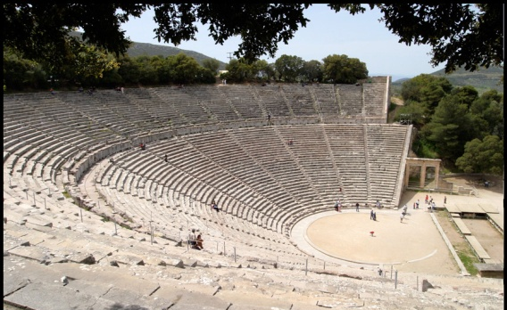
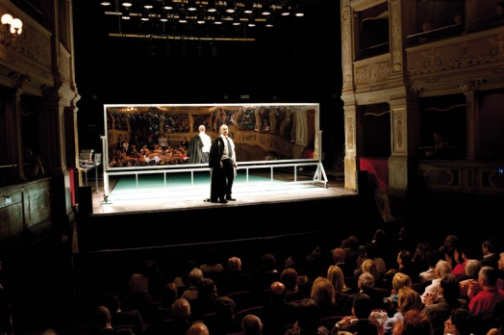
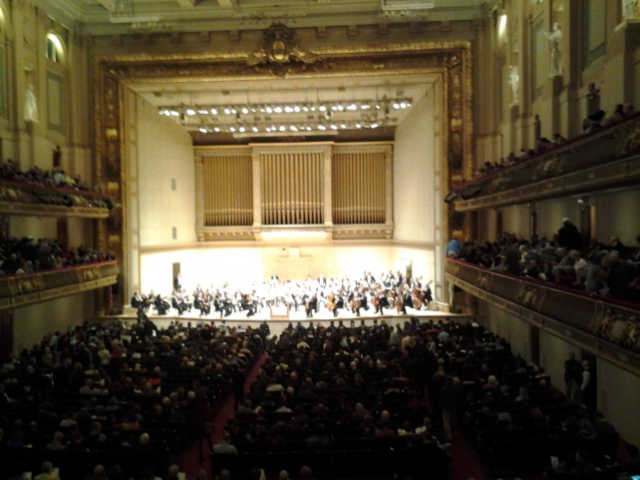
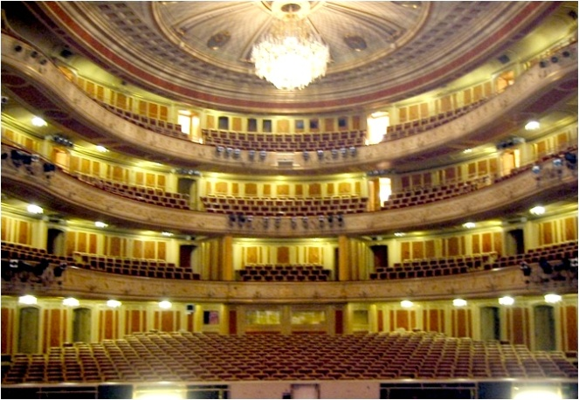
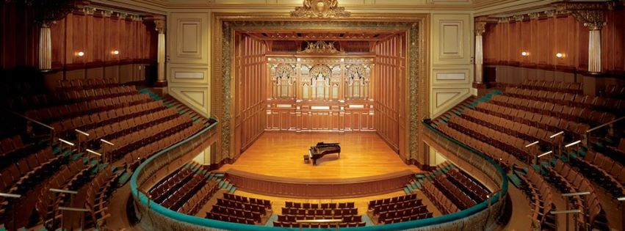
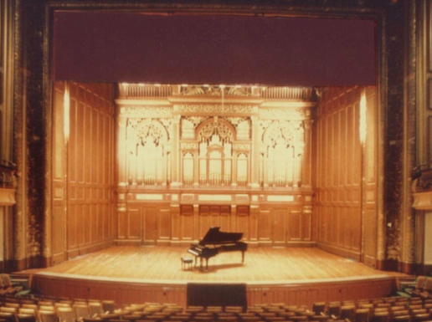
Excellent venues exist - but you will not find them with ISO3382
Epidaurus: D/R ~+4dB Spoleto: Teatro Caio Melisso: > 15,000 seats, Clarity A+ Festival dei Due Mondi
Front row first balcony Boston Symphony Hall. ~2700 seats D/R < -10dB, Clarity A+
(N. F. Declercq)
~350 seats, D/R > 0, A+
after and before renovation
Staatsoper Berlin Jordan Hall, New England Conservatory 1500 seats, A+ 1200 seats A-

Slide 9
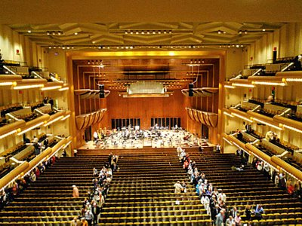
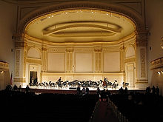
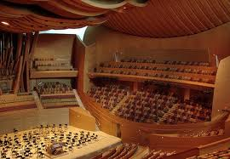
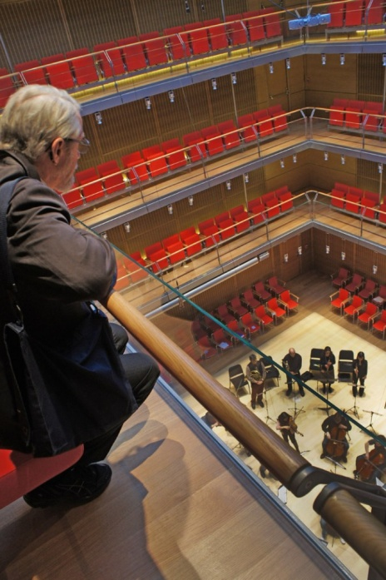
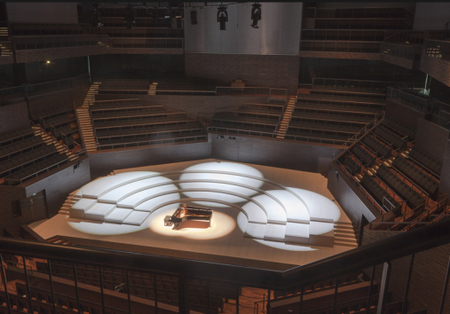
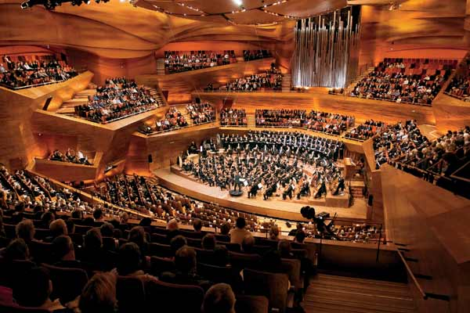
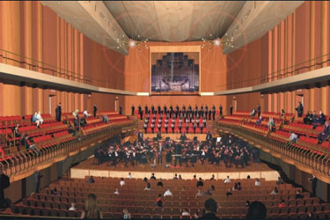
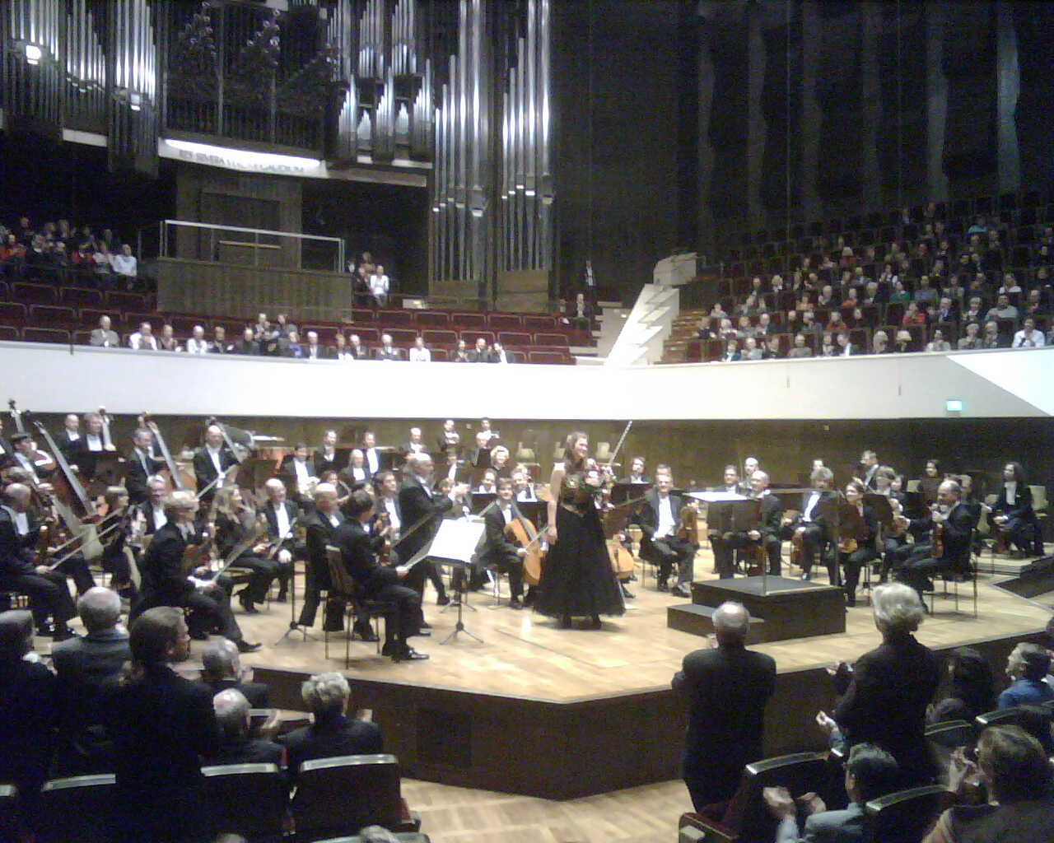
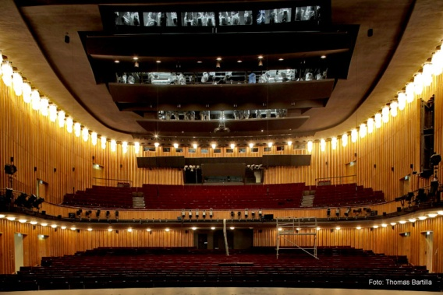
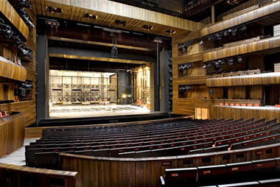
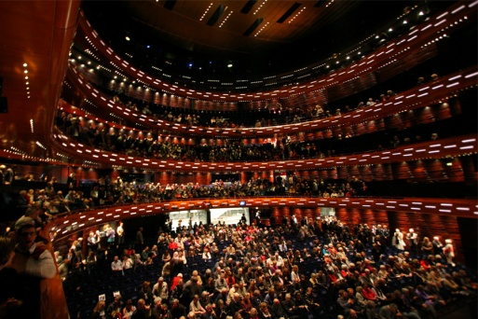
But many new halls, opera houses, and lecture rooms are sonically mediocre. With eyes closed the sound in most seats is weak and muddy. The words in song and music are often inaudible.

Slide 10






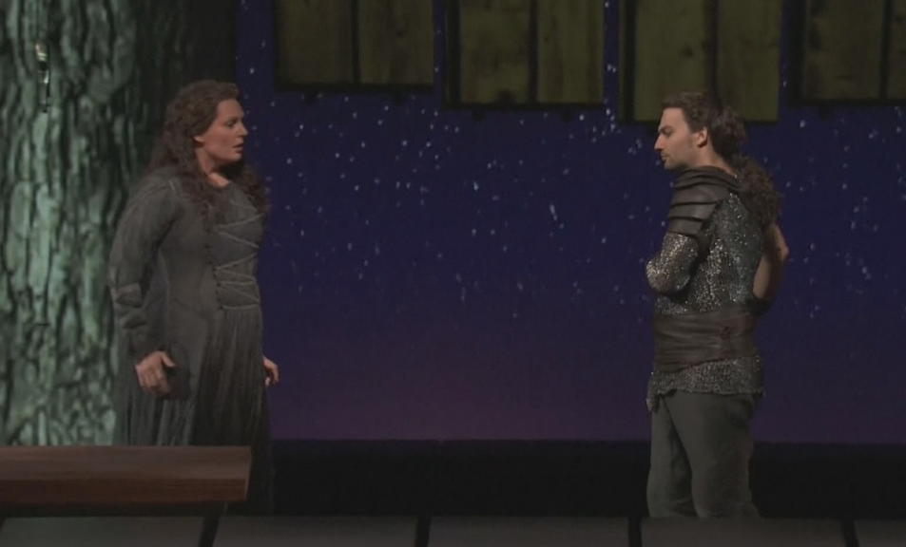



An opera without words is just a silent movie.
clear

Slide 11
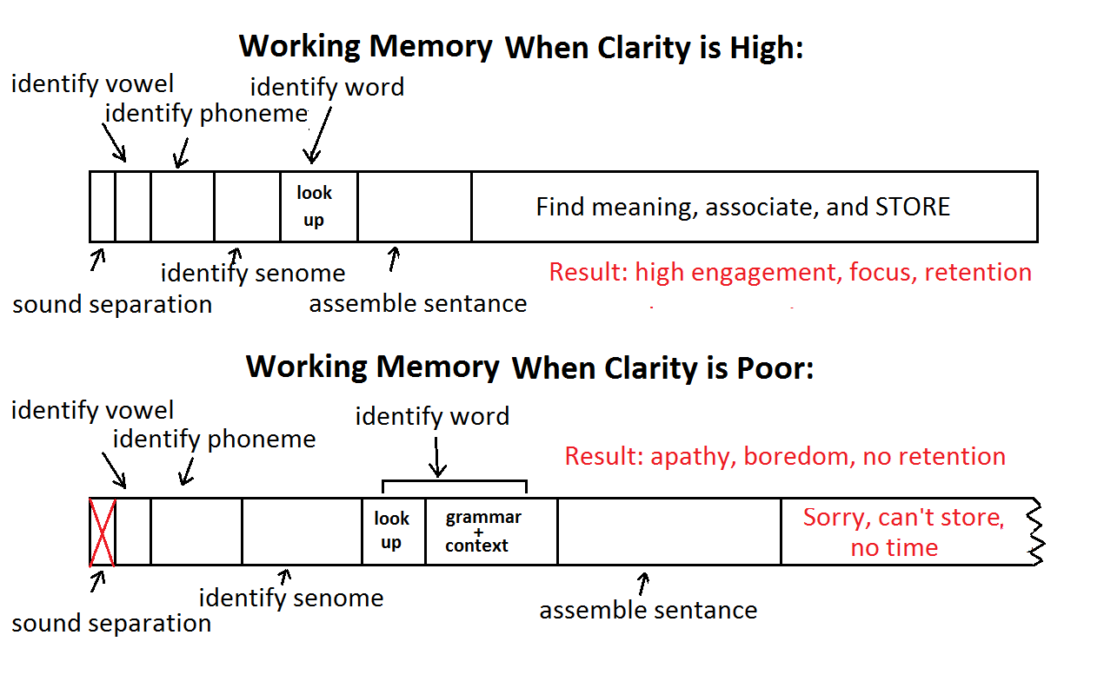
Classrooms to opera: where working memory is limited and clarity is essential.

Slide 12
What should we do?
ISO3382 analyses are based on a crude model of hearing.
Millions of years of evolution have given us a fantastic instrument for extracting information from a noisy and reverberant sound field.
better than any current device or algorithm.
To quantify “good” or “poor” acoustics we must understand in detail how this instrument works!
And how it fails.

Slide 13
What everyone knows:
Sound is detected in the inner ear with a continuous 1/3 octave filter.
Speech information is encoded in the relative strength of critical bands in the frequency range of 800 to 4000kHz, with some consonants at higher frequencies.
But these facts are inadequate to explain our acuity of hearing, or its limits in poor acoustics.

Slide 14
Why is this model inadequate?
Standard hearing models predict that loud whispering will be just as effective as voiced speech in a noisy environment.
But this is CLEARLY untrue.
Standard hearing models predict a pitch acuity limited by the 1/3 octave bandwidth of the basilar filters.
But musicians and listeners hear pitch to an accuracy of one part in one thousand!
Nearly all human and animal communication encodes information in the strength of harmonics of pitched tones.
WHY?

Slide 15
JASA - J. C. R. Licklider 1951
Licklider proposed that our acuity of hearing could be explained by an autocorrelator located as close as possible to the hair cells.
Explaining our sense of pitch, and the rules of harmony.
We now know this circuit exists – and it is directly below the hair cells.
Before signals are sent to the auditory nerve they have already been separated from each other by pitch.

Slide 16
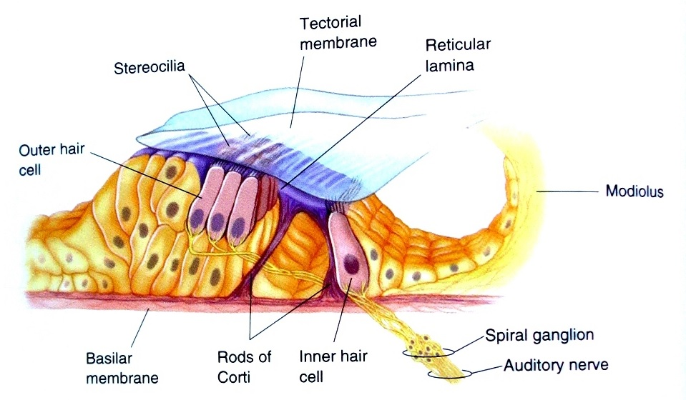
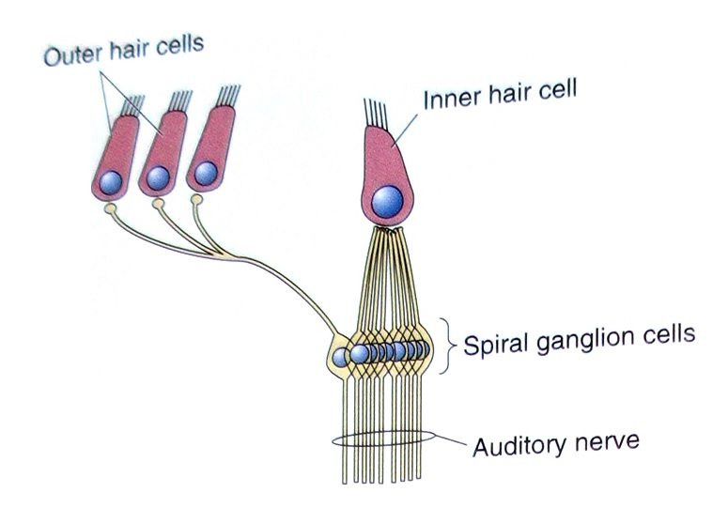
The Organ of Corti
Contains ~3000 inner hair cells, ~15,000 outer hair cells, and ~60,000 spiral ganglia. The inner hair cells detect basilar motion, the outer hair cells control the membrane sensitivity, and the spiral ganglia autocorrelate.
How do they work, and why are they needed?

Slide 17
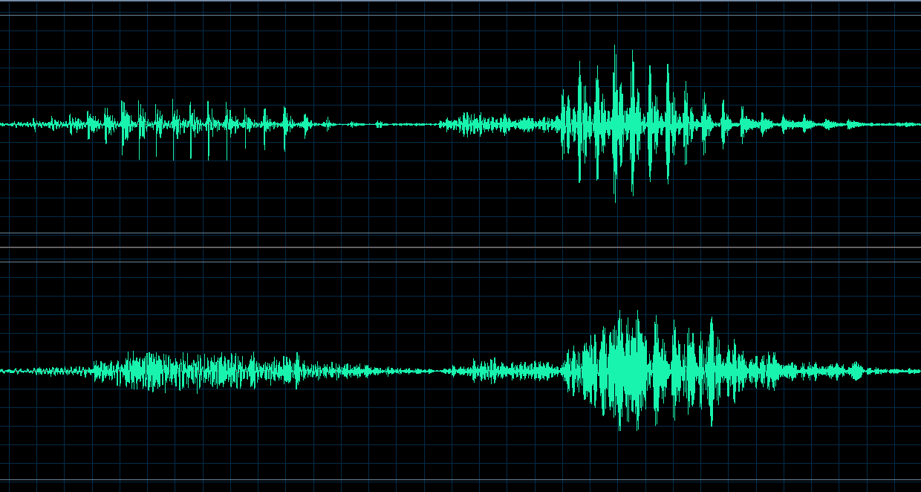
Because Both clear speech and music waveforms have SPIKES!
Broadband pressure waveforms of “One”
and “Two”
These features cut through noise and reverberation, but they are destroyed by excess reflections.
Standard hearing models and ISO3382 measures ignore the obvious differences in these peaks!
The same waveforms with excessive early reflections

Slide 18
Once in every fundamental period the PHASE of the harmonics aligns to form a peak pressure.
If there are four harmonics inside a critical band, once in every fundamental period the pressure increases by a factor of four, giving a 6dB increase in the signal to noise ratio.
If the hair cell outputs are sent to an autocorrelator with a length of four periods there is an additional S/N improvement of 6dB.
A 12 dB advantage in S/N is an enormous advantage to an organism!
Speech recognition algorithms are just beginning to realize the importance of PHASE!

Slide 19




The autocorrelator in the organ of Corti also enables source separation
The ability to separate simultaneous pitched signals is essential to surviving parties and enjoying polyphony.
We can separate two simultaneous talkers from each other if their vocal pitches are different by as little as half a semitone!
Without the peaks created by the phases of harmonic tones we cannot separate or localize these signals.
After separation by pitch
C and C# mixed

Slide 20
What about Envelopment?
Bradley and Soulodre show that envelopment depends on late reverberant level.
“Late” is defined by the onset of the direct sound. But the definition makes no sense if the direct sound is inaudible.
Envelopment requires separation of a sound into two distinct streams: a foreground stream and a background stream.
When a foreground stream is not perceived, there is only one stream, perceived as reverberant but not surrounding.
Vienna’s Musikverrein and Boston’s Symphony Hall set the world standard for envelopment, but in both halls reverberation comes from the front in distant seats.

Slide 21
When does the Corti’s autocorrelator fail?
The perception of Clarity fails three ways:
1. When the phases at the onsets of sounds are randomized by too many early reflections.
Solution: limit early reflections.
2. When reverberation from a previous sound or note masks the onset of a succeeding note.
Solution: Control the reverberation time and level.
3. When upward masking from excessive sound power at low frequencies disturbs the hair cells in the vocal formant frequencies.
Solution: Don’t design for maximum RT at low frequencies.
World Class Acoustics depends on minimizing all three of these problems!

Slide 22
Summary of the physics of communication
Most creatures communicate with harmonics of pitched tones because it increases the signal to noise ratio by 12dB or more.
But the increase in S/N and the ability to separate sounds depend on the phase alignment of the upper harmonics, and these phases are altered by acoustics.
When phases are preserved at the onsets of sounds we get CLARITY – otherwise we get MUD.
Clarity encourages focus and remembering.
Mud encourages apathy and boredom.

Slide 23
Three Measures for Clarity
From Impulse responses:
Using the heuristic measure LOC
Using phase analysis of the IR
From live speech:
Using an accurate model of human hearing

Slide 24
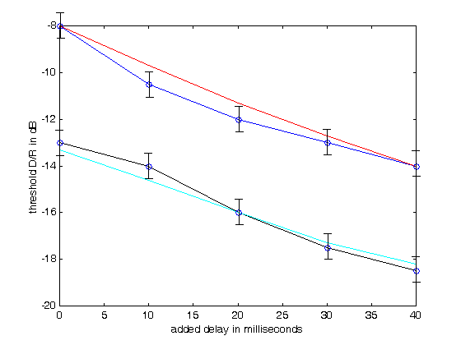
The first measure, LOC, uses the ability to sharply localize sound as a proxy for Clarity.
We determined the threshold of localization of voiced speech as a function of D/R and pre-delay for exponential decay with RT = 1s and RT = 2s.
For a 2s RT the threshold of localization can be as low as -17dB.
We developed the function LOC to predict this data. The red and cyan lines show the accuracy of the fit.
The LOC measure has been tested in real rooms and halls with useful results.

Slide 25
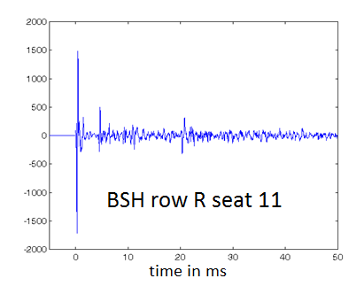
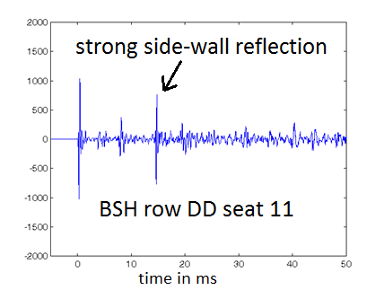


Example: Two seats in Boston Symphony Hall
C80 = 0.85dB IACC80 = .68 LOC = 9.1dB
C80=-0.21 IACC80 = 0.2 LOC = -1.2dB
C80 predicts no difference. IACC predicts row DD sounds better. LOC gets it right!

Slide 26
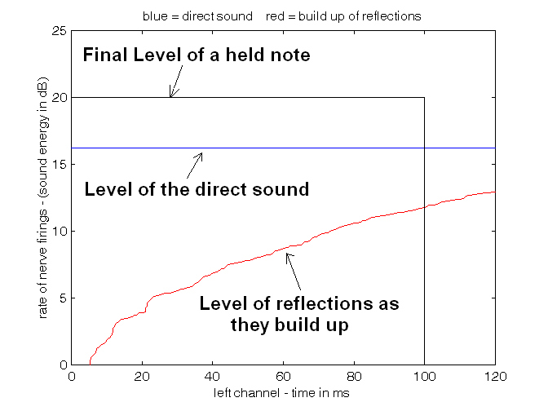
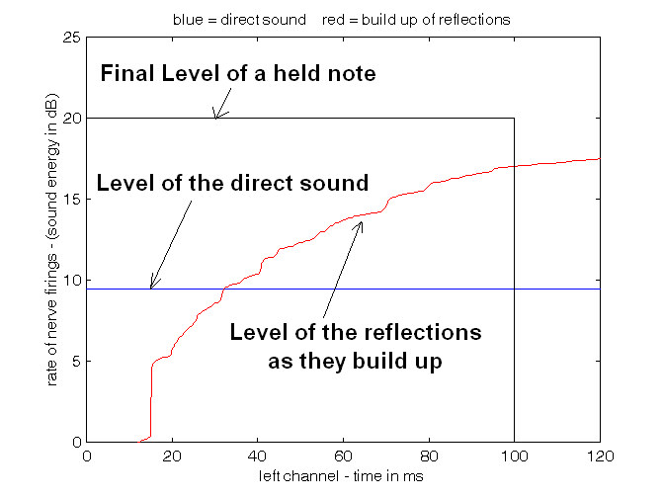
Here is how LOC sees the IRs:
row R seat 11. LOC = 9.1dB
row DD, seat 11. LOC = -1.1dB
LOC is the ratio in dB of the area under the blue line inside the black box, divided by the area under the red line inside the box. LOC > 3db indicates good clarity.

Slide 27
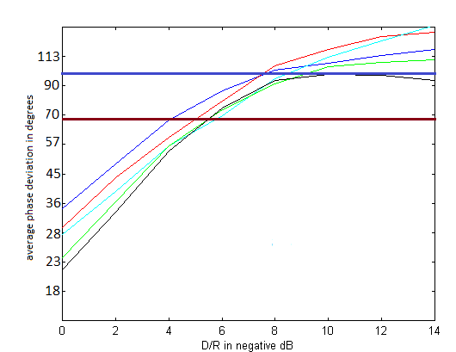
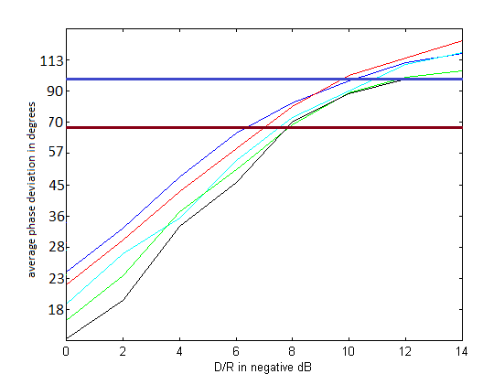
The second measure of Clarity analyzes an impulse response for the coherence of phase between frequencies corresponding to adjacent harmonics.
Each line is the average of the phase jitter in degrees for five pre-delays in bands from 800 to 4000Hz (averaged 16 times.)
RT = 1s
RT = 1s
RT = 2s
The blue line approximately matches the localization thresholds determined by LOC. The red line indicates a value low enough for good clarity.

Slide 28
The third measure quantifies Clarity from live speech using a model of hearing
Clarity depends on the peaks in the pressure waveform created by the harmonics of pitched tones.
We can measure the degree of clarity by the ratio between the peak heights at the output of the pitch-sensitive autocorrelator to the average power at the input to the correlator.
When clarity is high, the ratio will be high. When it is low, the ratio will be low.
The result will vary with the speech phonemes, but as little as 10 seconds of speech can give meaningful results.
The result depends on all three of the mechanisms that degrade clarity – lack of harmonic coherence, excessive reverberation, and excessive bass boom.

Slide 29
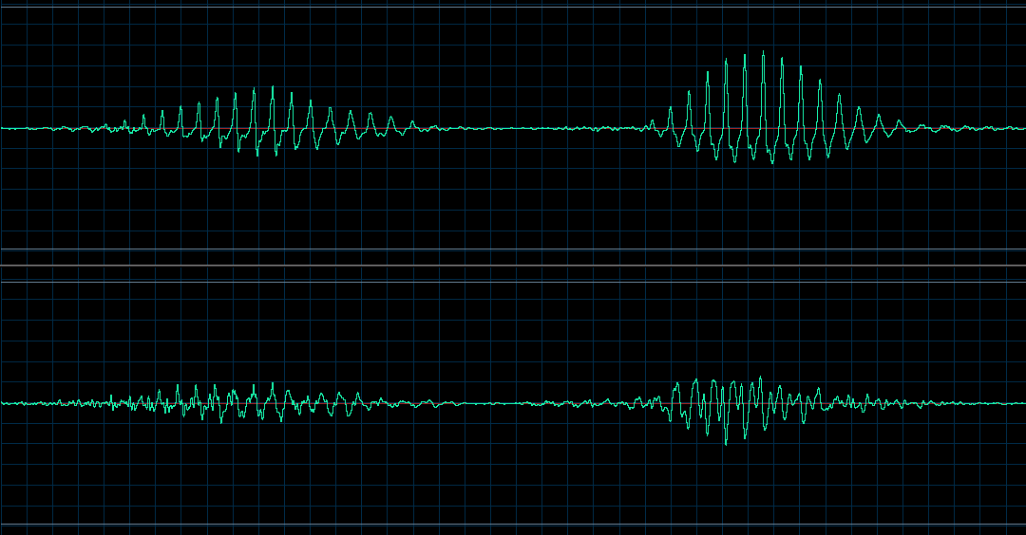
“one two:” correlator output from a 1600Hz critical band.
Signal at the output of a 4 period correlator.
Same but with randomized phase.
The difference in peak amplitude of these two signals can be used as a real-time measure of clarity.

Slide 30
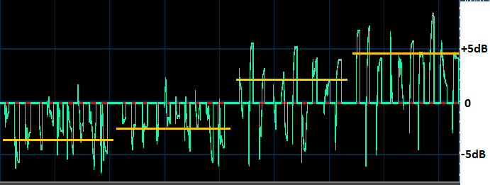

Example: The numbers 1 to 10 repeated four times with increasing clarity.
All the sequences have C50 = infinity and STI > 96.
Click for sound

Slide 31
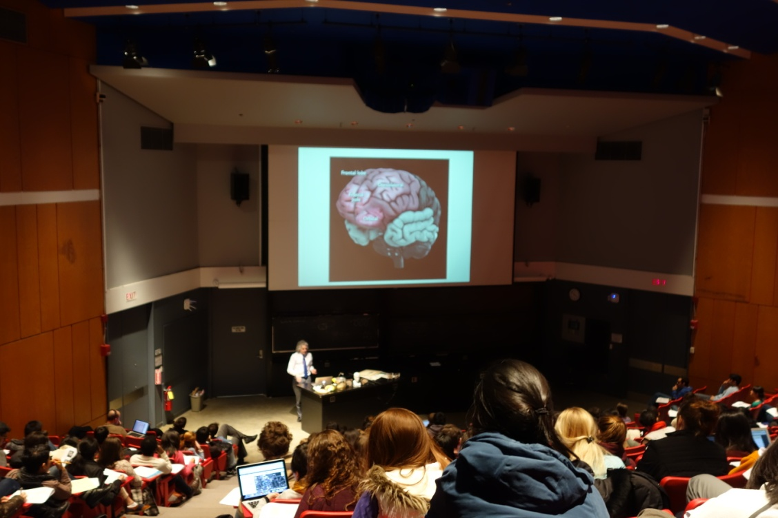
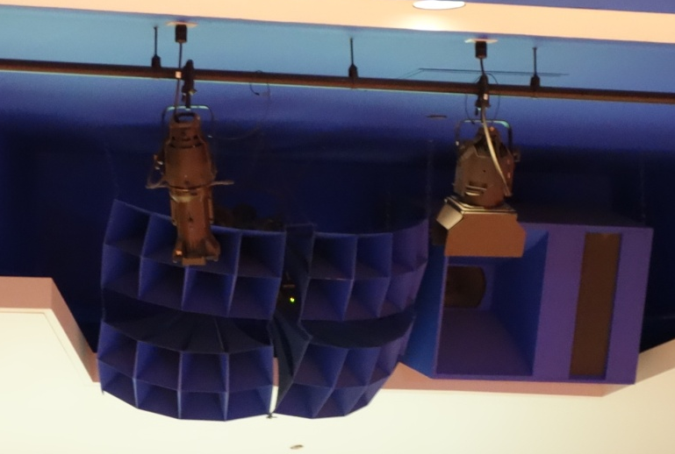
Measured Clarity in a Classroom
Harvard Science Center C: ~200 sharply raked seats. Large muticellular horn speaker.
Students in the rear were chatting to each other and playing with their smart phones. Why?

Slide 32
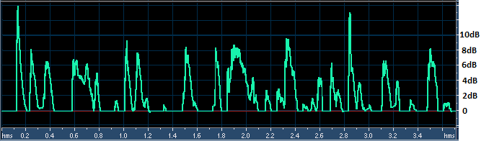

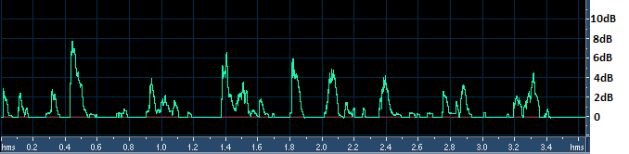

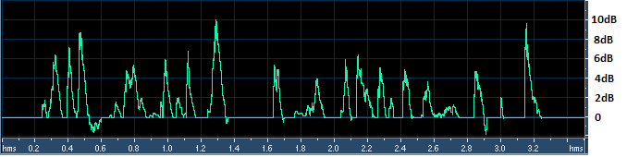

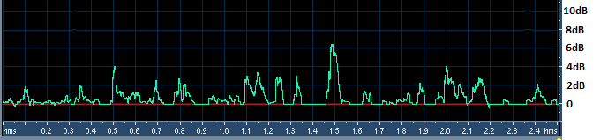
Results: Clarity ratios with live speech
Clarity with no microphone in the front of the hall.
In the rear of the hall with no microphone.
In the front of the hall with the microphone.
In the rear with the microphone. Clarity is poorer with amplification.

Slide 33
What to do?
Demand that architects put audience in front of performers.
Find and use ways to predict if the direct sound will be audible in most of the seats in a venue.
Don’t ignore the importance of both G and Glate in hall design.
Don’t study acoustics or hearing with sine-tones, noise-bursts, and clicks! Use speech, music, and syllabic tones (cellos, oboes, etc.)
Learn how to make and reproduce binaural recordings of live performances at your eardrums.
Don’t believe any simulation until you can verify it precisely with a binaural recording!

Slide 34
Conclusions
ISO3382 analyses for Clarity are based on obsolete theories of hearing. The evolution of the ear and brain demands that the direct sound be audible.
Current hall designs are turning live performances into spectacles for tourists, driving audiences to movies and recordings.
Current classroom design and sound reinforcement strive for loudness over engagement, understanding, and remembering.
The ancient Greeks knew better.

